Slide 1



Great Datasets: A Story
Alex Cookson
@alexcookson
tacookson
_

Slide 2
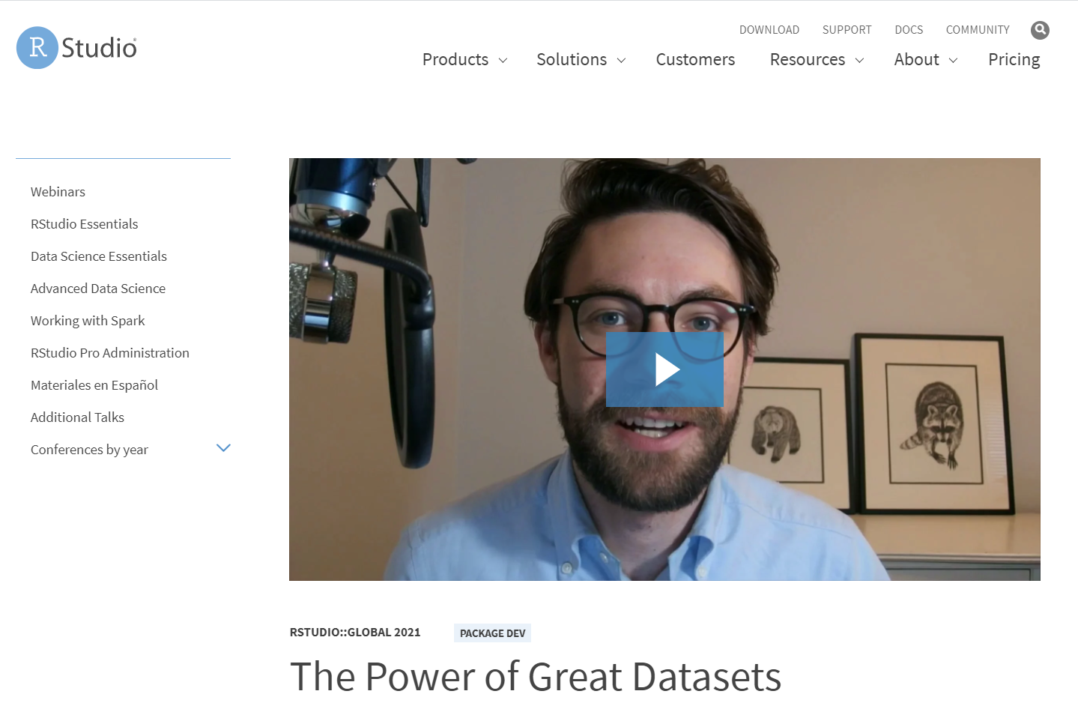
Bored?
Watch the 5-minute version of this talk

Slide 3
Set up the structure
Boy meets boy
Boy meets girl
Non-gendered person meets girl
Etc.
Learner meets Data

Slide 4
Rom-com
The Meeting
Sparks Fly
Tension/Crisis
Falling in Love

Slide 5
The Meeting
Seeing Hamilton
Brother (big Broadway fan) told me about weekly grosses, published by the Broadway League
[Description of data]
Curiosity piqued

Slide 6
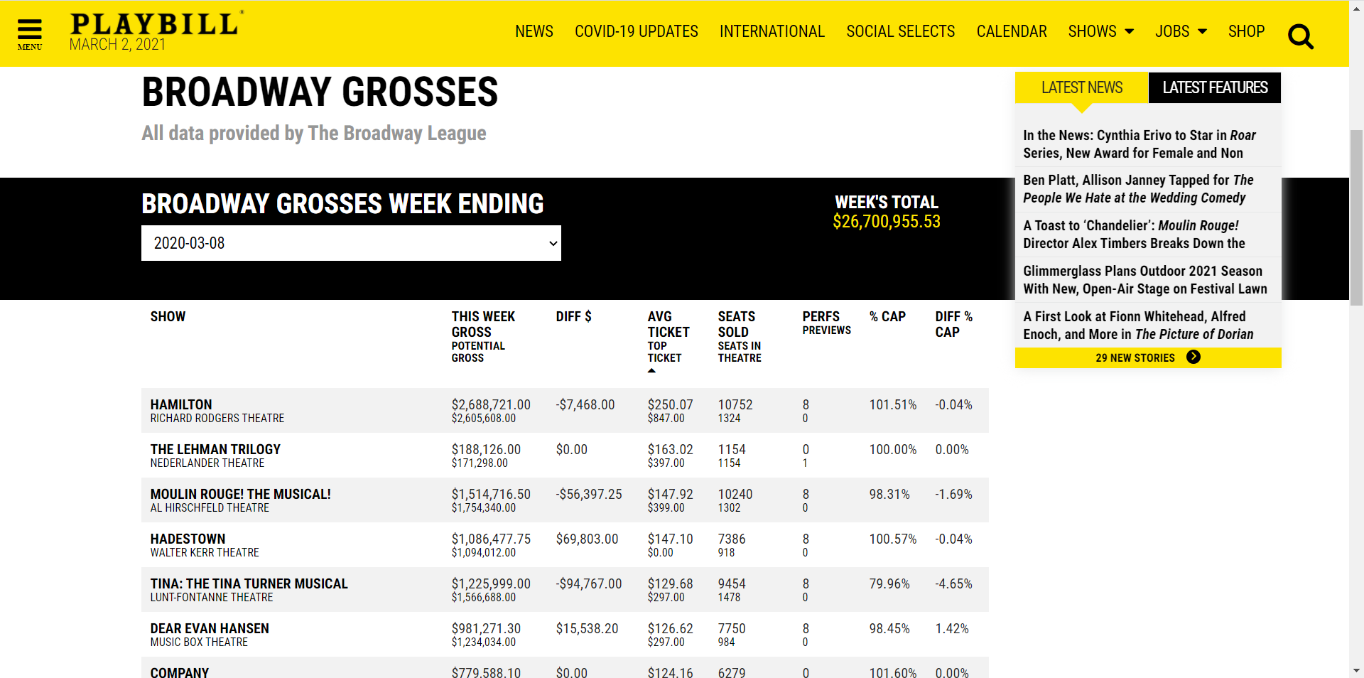
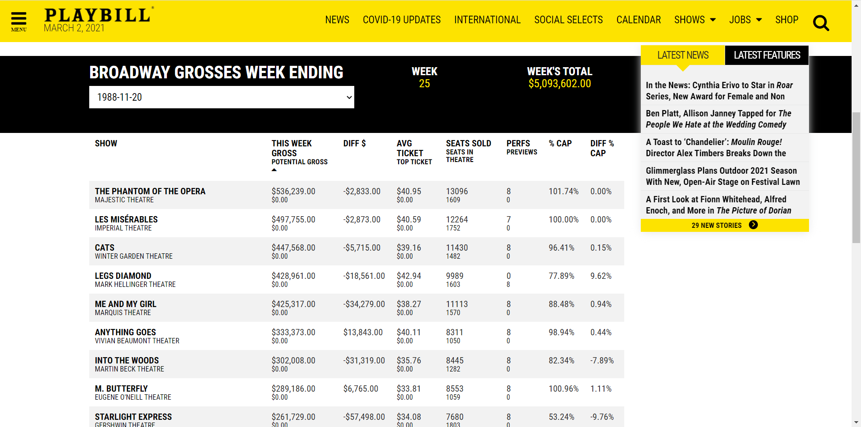
Sparks Fly
Cool data confirmed!
Ask questions like, “How expensive are Hamilton tickets really?
What was popular the week I was born? (data goes back to 1985)

Slide 7
Tension/Crisis
Thought: exploring the data week-by-week is okay
I don’t want data (one week at a time) – I want DATA (full dataset)
Problem: I knew exactly where the data was, but I couldn’t get to it
Solution: learn how to web-scrape (rvest, html tags)

Slide 8
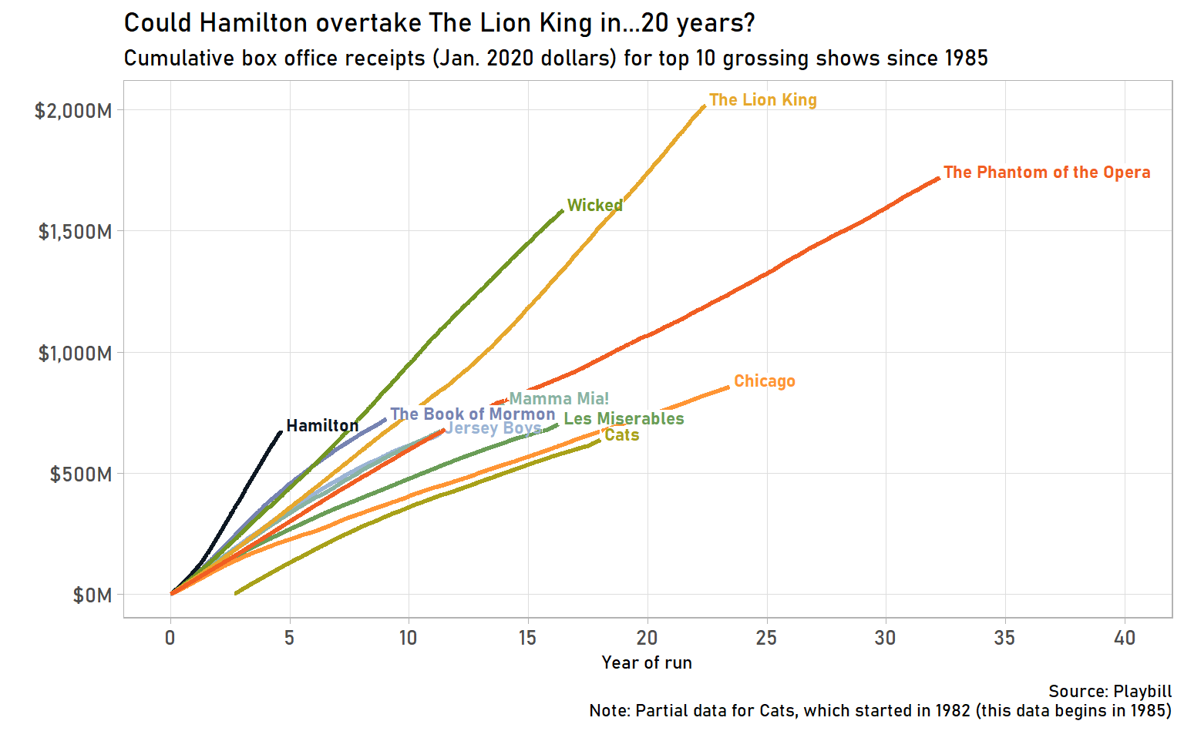
Falling In Love
Scraped data
Wrote a blog post
Submitted dataset to #TidyTuesday
David Robinson saying “This is so cool!” about this dataset

Slide 9

Falling in Love

Slide 10
Love Story kept repeating itself
Japanese mascots (use Google Language API)
Sakura flowering (gganimate)
Fictional character personalities (Principal Component Analysis)
U.S. diplomatic gifts (parsing PDFs, natural language processing)

Slide 11
Great Datasets: A Story
Alex Cookson
@alexcookson
tacookson
_

Slide 12
Great Datasets: A Story
—
—
^
ies
—
^
Many
Alex Cookson
@alexcookson
tacookson
_

Slide 13

Great Datasets as a display of individuality
The datasets you work with and share can be a reflection of who you are

Slide 14
Great Datasets as a learning path
Typical learning path: identify outcome → find dataset → practice on dataset
Motivation comes from getting to the outcome
Example: prediction of binary outcome → Titanic dataset → practice
Great dataset learning path: find dataset → identify outcome → practice on dataset
Motivation comes from inherent interest in the dataset
Example: Broadway grosses dataset → Web scraping / Data visualization / Causal inference

Slide 15
Great Datasets as giving back to the community
If you find something interesting, someone else will too
It feels good to be recognized/thanked for work you’ve done

Slide 16
Common Questions
Where can I find great datasets?
How do I start putting together my own datasets?

Slide 18
How do I learn how to do [thing] in R?

Slide 19
How do I learn how to do [thing] in R?
[ sentiment analysis ]
[ data visualization ]
[ web scraping ]
[ forecasting ]
[ … ]

Slide 20
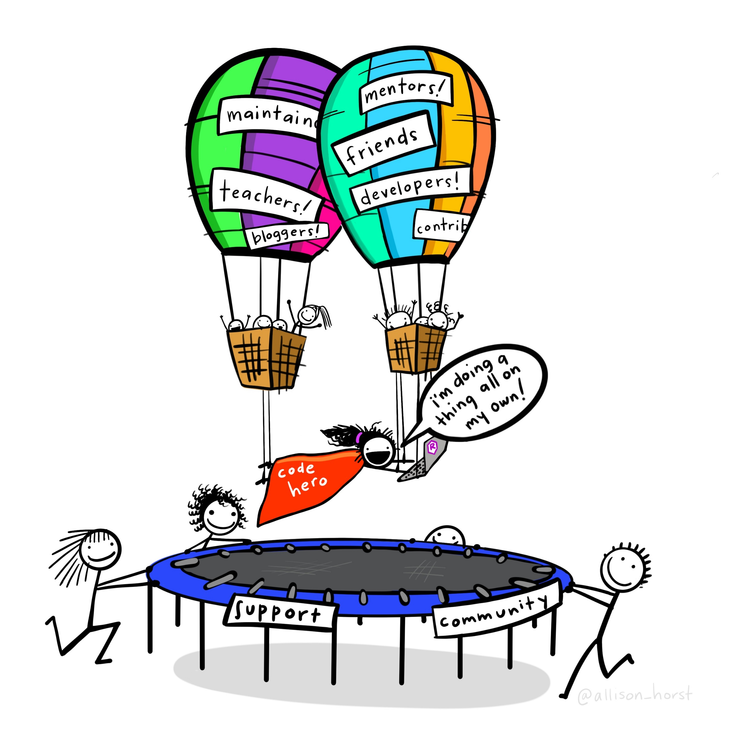
Artwork by @allison_horst

Slide 21
What about
Great Datasets are
?

Slide 22
Great Datasets are COOL

Slide 23
Great Datasets are COOL
and
INTERESTING

Slide 24
Great Datasets are COOL
and
INTERESTING

Slide 25
Great Datasets are COOL
and
INTERESTING
“That’s cool!”
Cool to me isn’t (necessarily) cool to you
Speaks to you on a deeper level

Slide 26
Great Datasets are COOL
and
INTERESTING

Slide 27
Great Datasets are COOL
and
INTERESTING
Prompts you to ask questions
Rouses your curiosity
“Just one more graph”

Slide 28
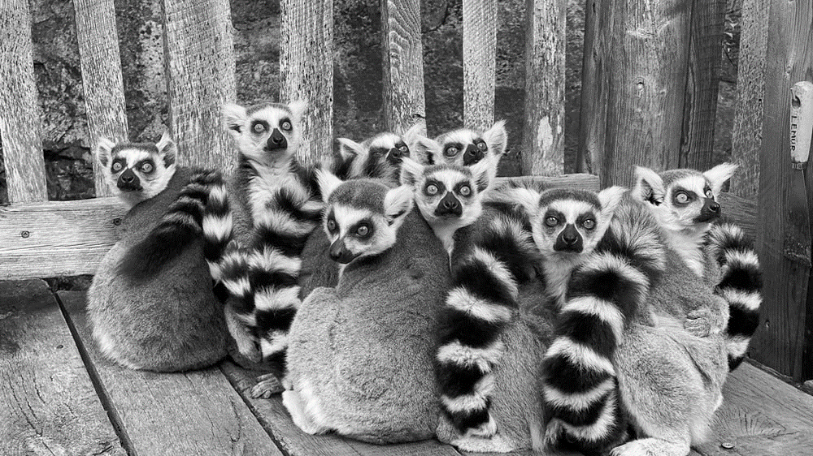
Duke Lemur Center
Ring-tailed Lemurs have an average weight of 2.2kg

Slide 29

Broadway Grosses
Hamilton holds the record for top ticket price on Broadway — $998

Slide 30
Fictional Character Personalities

Slide 31
Fictional Character Personalities

Slide 32
Fictional Character Personalities
Traits of 800 characters across 250+ spectrums

Slide 33
Fictional Character Personalities
Traits of 800 characters across 250+ spectrums
Playful
Serious

Slide 34

Fictional Character Personalities
Traits of 800 characters across 250+ spectrums
Michael Scott
(The Office)
Playful
Serious

Slide 35
Fictional Character Personalities
Traits of 800 characters across 250+ spectrums
Worf
(Star Trek: The Next Generation)
Michael Scott
(The Office)
Playful
Serious

Slide 36
What are some of my favourite characters’ personalities?

Slide 37
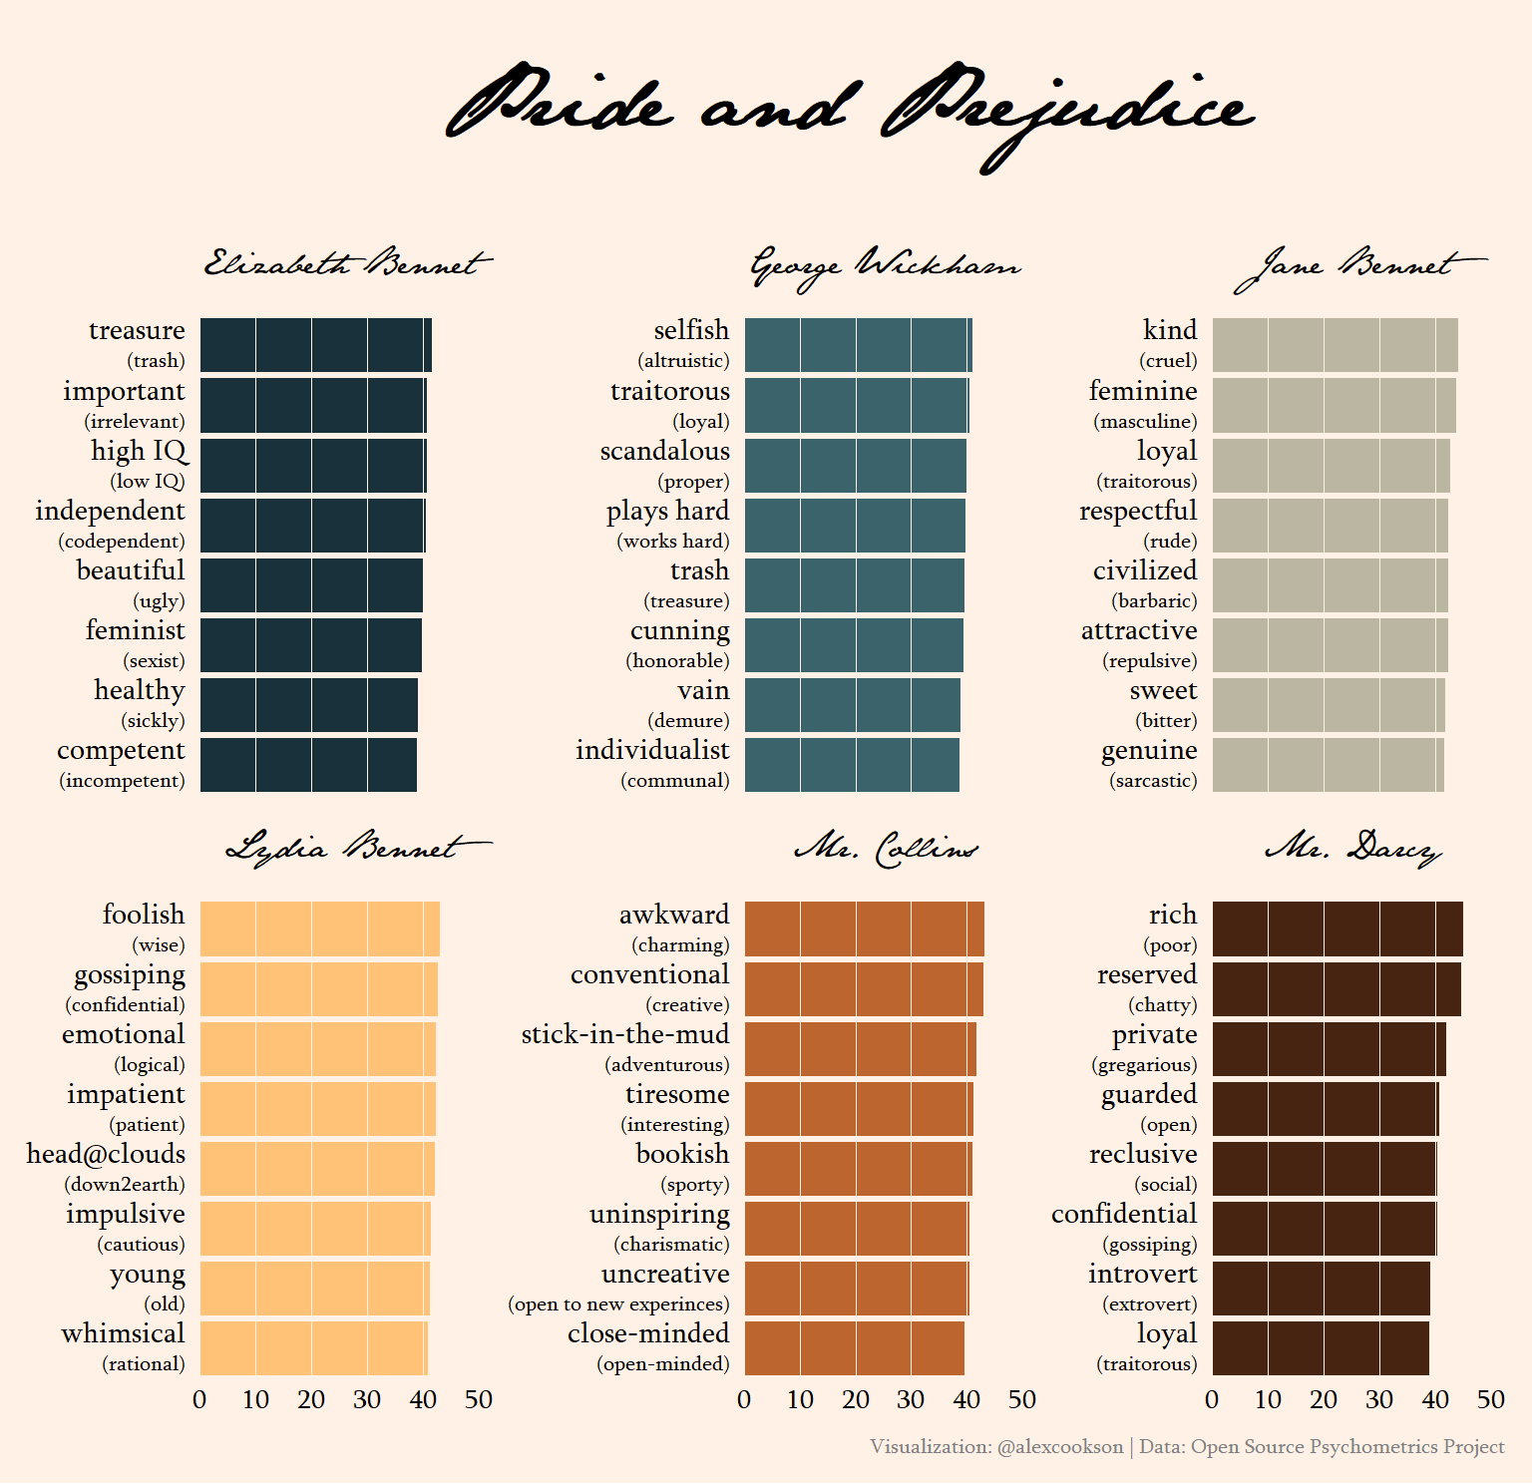

Slide 38
Use custom fonts
Tweak labels with {glue} and {ggtext}
Choose an appropriate colour palette
Adjust a LOT of theme() elements

Slide 39
Which characters are most similar to one another?

Slide 40
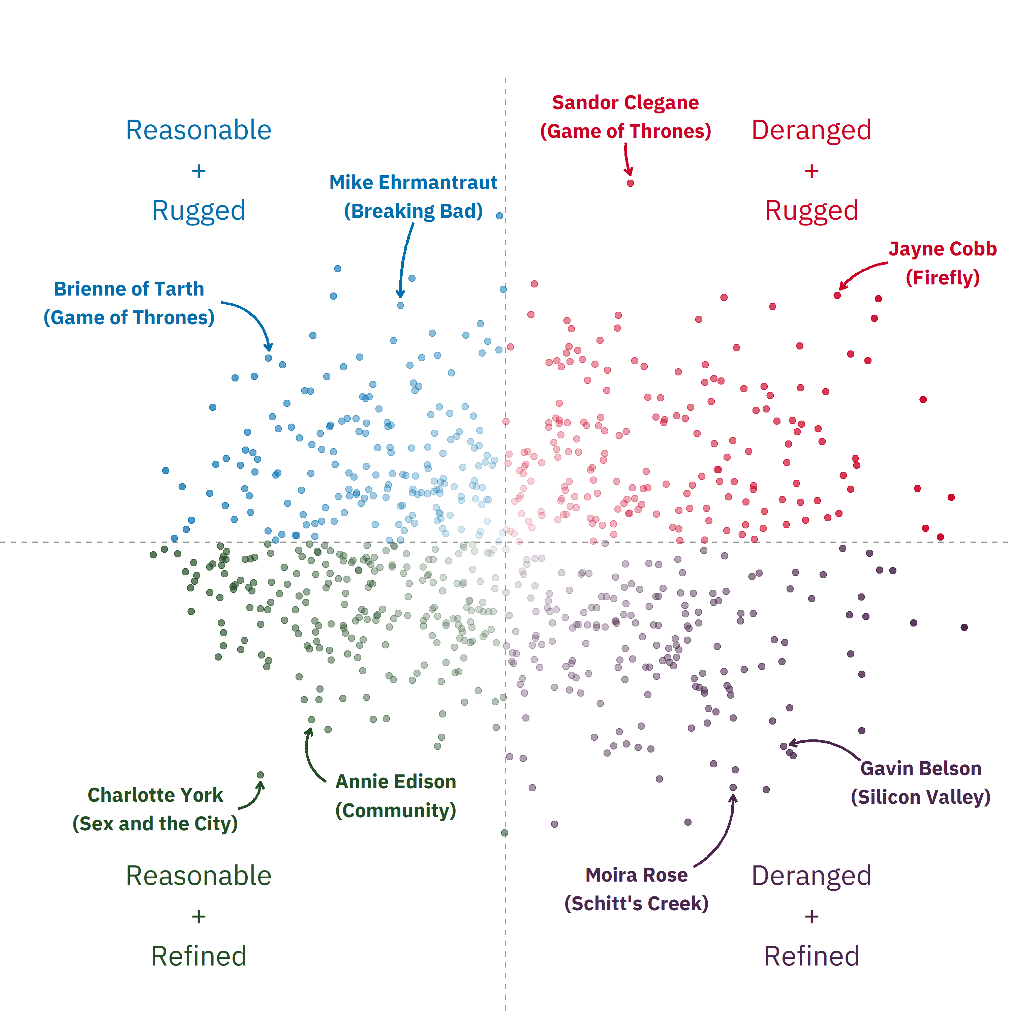

Slide 42
Conduct Principal Component Analysis (PCA) with {tidymodels}
Add text and arrow annotations
Make an interactive chart with {plotly}

Slide 43
I’ll be honest…

Slide 44
I would never put this much effort into analyzing Titanic passengers

Slide 45
Artwork by @allison_horst

Slide 46
great data
Artwork by @allison_horst

Slide 47
The Power of Great Datasets
Alex Cookson
@alexcookson
tacookson
Thank You Allison Horst for the amazing illustration

